Slide 1
Makana
QR code placement
(Apra to create)
edimaudo@gmail.com

Slide 2
Makana mean Gift in Hawaiian

Slide 3
Donation Overview

Slide 4
The Challenge
5
$1006
CRM Interaction Types
2025 Avg. Gift Amount
Recently, your organization expanded, attracting a new pool of potential donors. With this expansion, the vice president of advancement has tasked your team with developing data-driven fundraising portfolios for the new prospect pool. This challenge is not just about identifying prospects but about strategically organizing them into portfolios that maximize fundraising efficiency and impact.
10
4
# of Years used in analysis
# of Datasets

Slide 5
Donation Data Insights

Slide 6
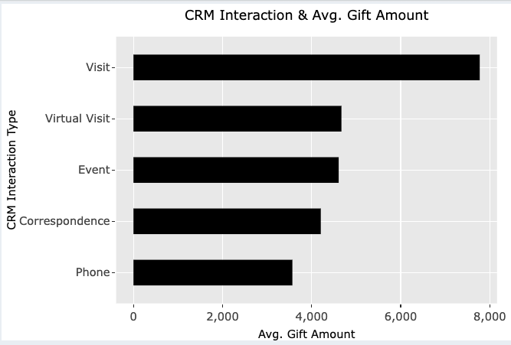
Visits are aligned with higher gift amounts
Opportunities to improve donation approach with respect to virtual visits and event approaches

Slide 7
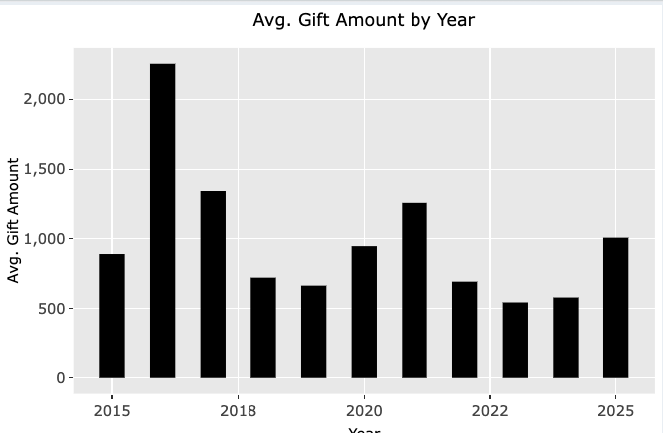
2016 saw the highest average gift amount of $2260
2025 is showing a better average gift amount compared to the last 3 years
Opportunity to have a consistent gift amount year after year

Slide 8
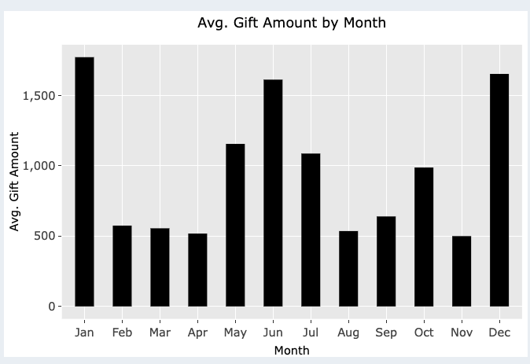
January, June and December are pivotal gift giving months
Opportunity to drive more gift giving in low periods like February - April

Slide 9
Donor Portfolio

Slide 10
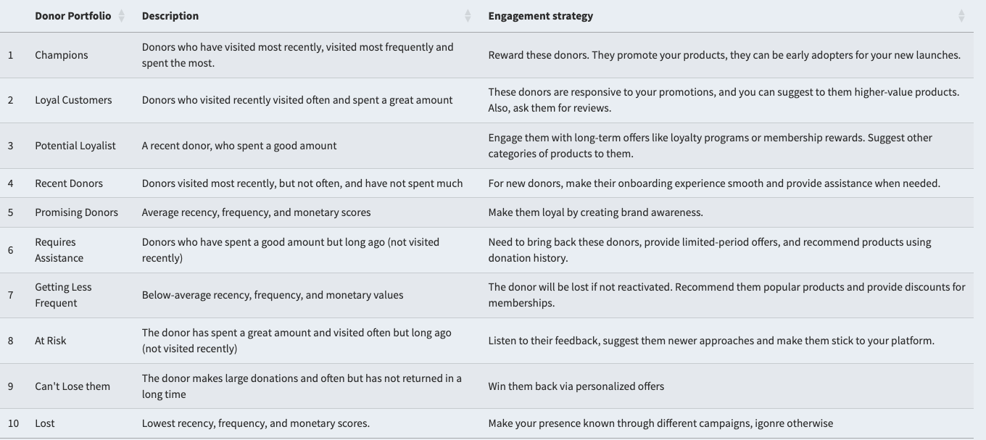
Leverages RFM Analysis to segment donors using R
Highlights engagement strategy for each donor group

Slide 11
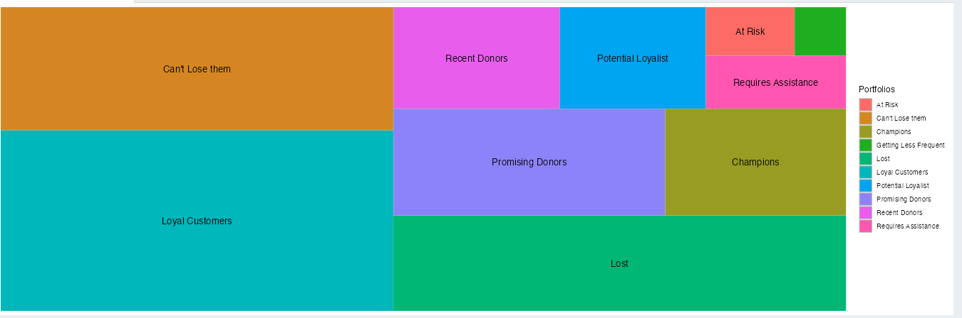
Highlights the different donor segments
Opportunities to improve engagement with Promising donors, Can’t Lose Them, Loyal Customers
Have to reduce the amount of Lost donors

Slide 12
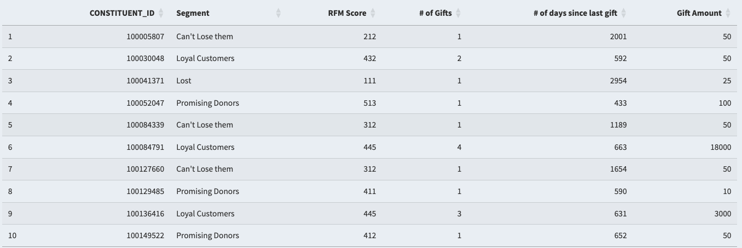
Constituents assigned to donor segments
Can leverage the donor segment and drive tailored engagement strategy
Use donor segments for donation opportunities
forecasting future gifts
Predicting gift amounts

Slide 13
Donation Opportunities

Slide 14
Gift Forecasting

Slide 15
Next Best Gift

Slide 16
Next Steps

Slide 17
Build out weekly, monthly and yearly insights using donation KPIs
Connect donor segment data to CRM
Detailed dive into video communication opportunities

Slide 18
Appendix

Slide 19
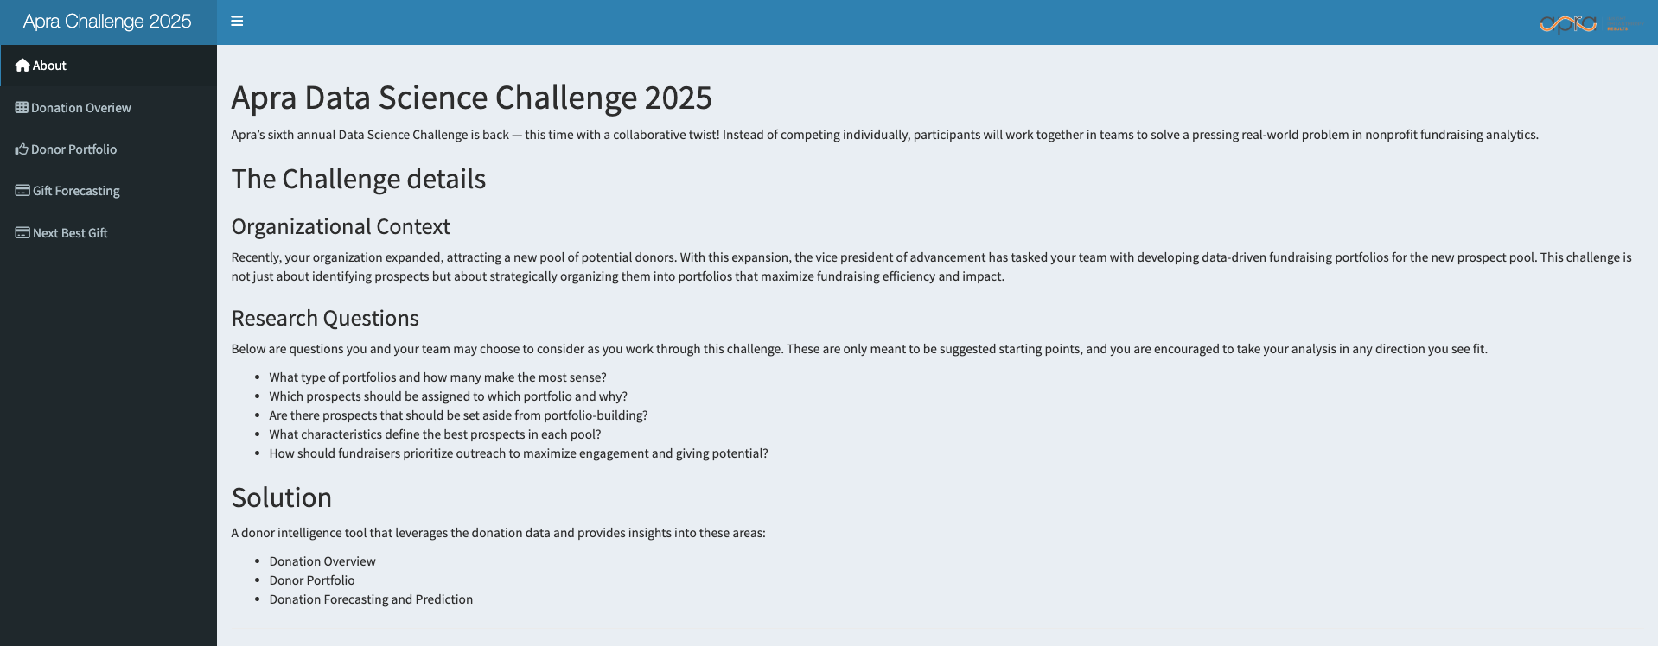
About Section

Slide 20
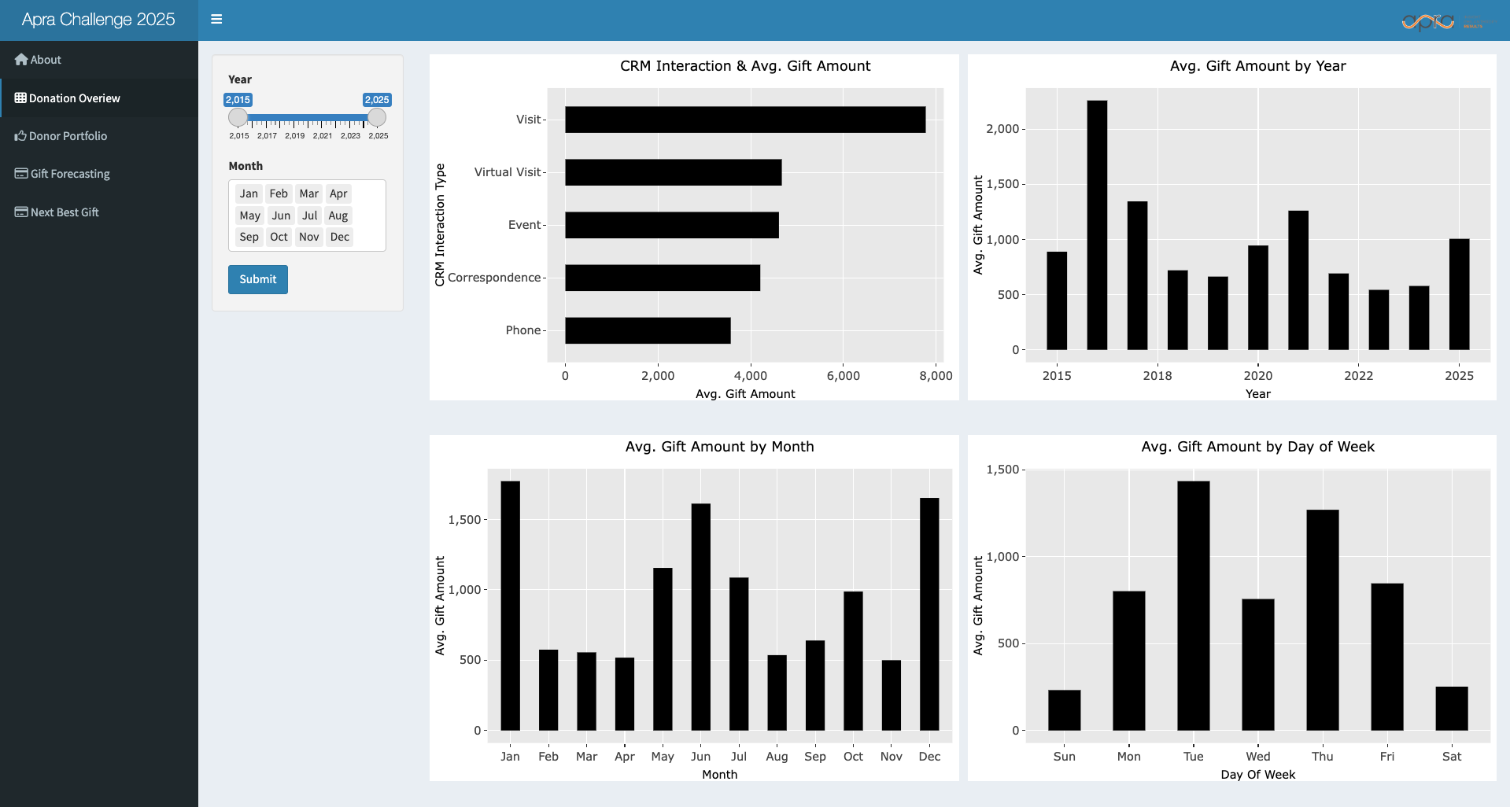
Donation Overview Section

Slide 21
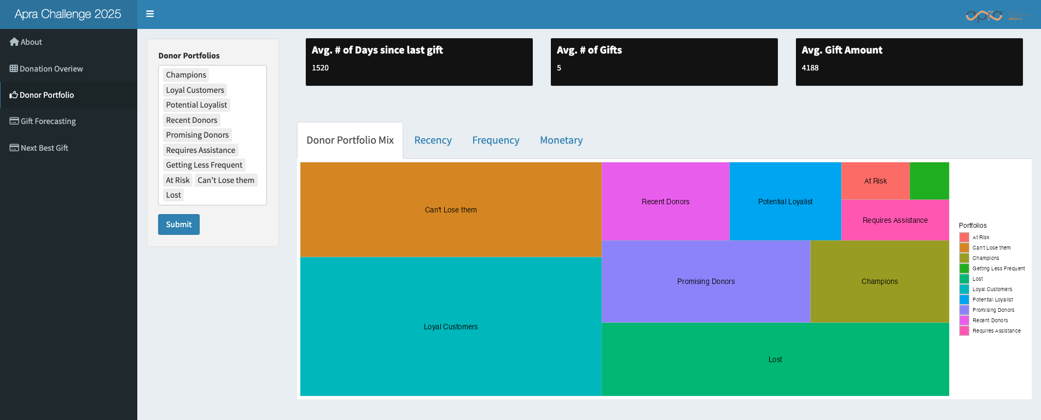
Donor Portfolio Section

Slide 22
Donor Portfolio Section

Slide 23
Donor Portfolio Section

Slide 24
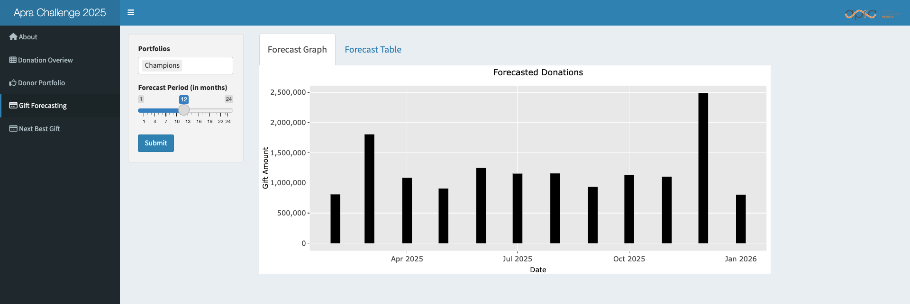
Gift Forecasting Section

Slide 25
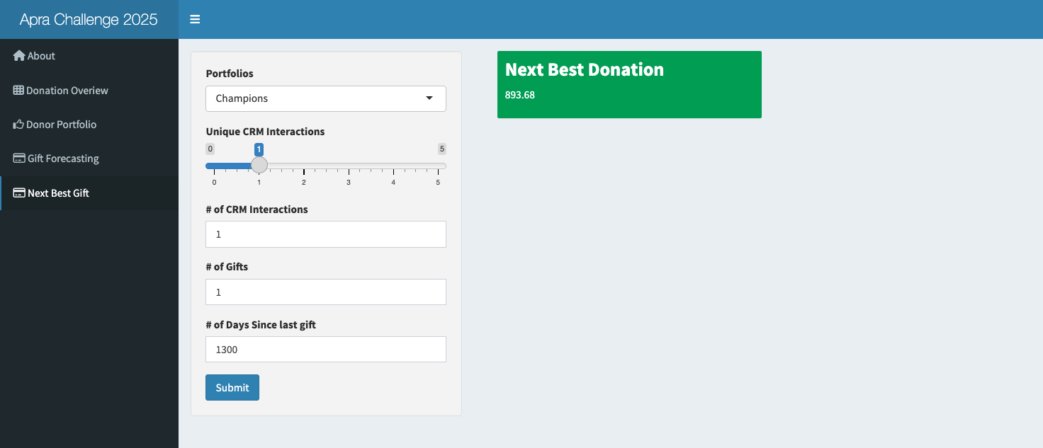
Gift Prediction Section

